Slide 1
Task 3

Slide 2
Vulnerability Report
Title: Cross Site Scripting
Domain: Vulnweb.com
Subdomain: testasp.vulnweb.com

Slide 3
Steps to Reproduce:
Step 1: Visit http://testasp.vulnweb.com/
Step 2: On the top menu you will find a search option.
Step 3: Click on it and you will be prompted with the Search box.
Step 4: You can intercept the request in Burp Suite
Step 5: Now you can find different payloads for XSS.

Slide 4
Step 6: Send the request to the intruder and paste all the payloads.
Step 7: Try to find a successful payload for XSS.
Step 8: Prepare a report for it.
Impact:
Cross Site Scripting can lead to data breach for your user's data and it can be harmful for your website.
Mitigation:
In order to prevent cross site scripting attack then you can enable noscript on browser.

Slide 5
POC
Video

Slide 6
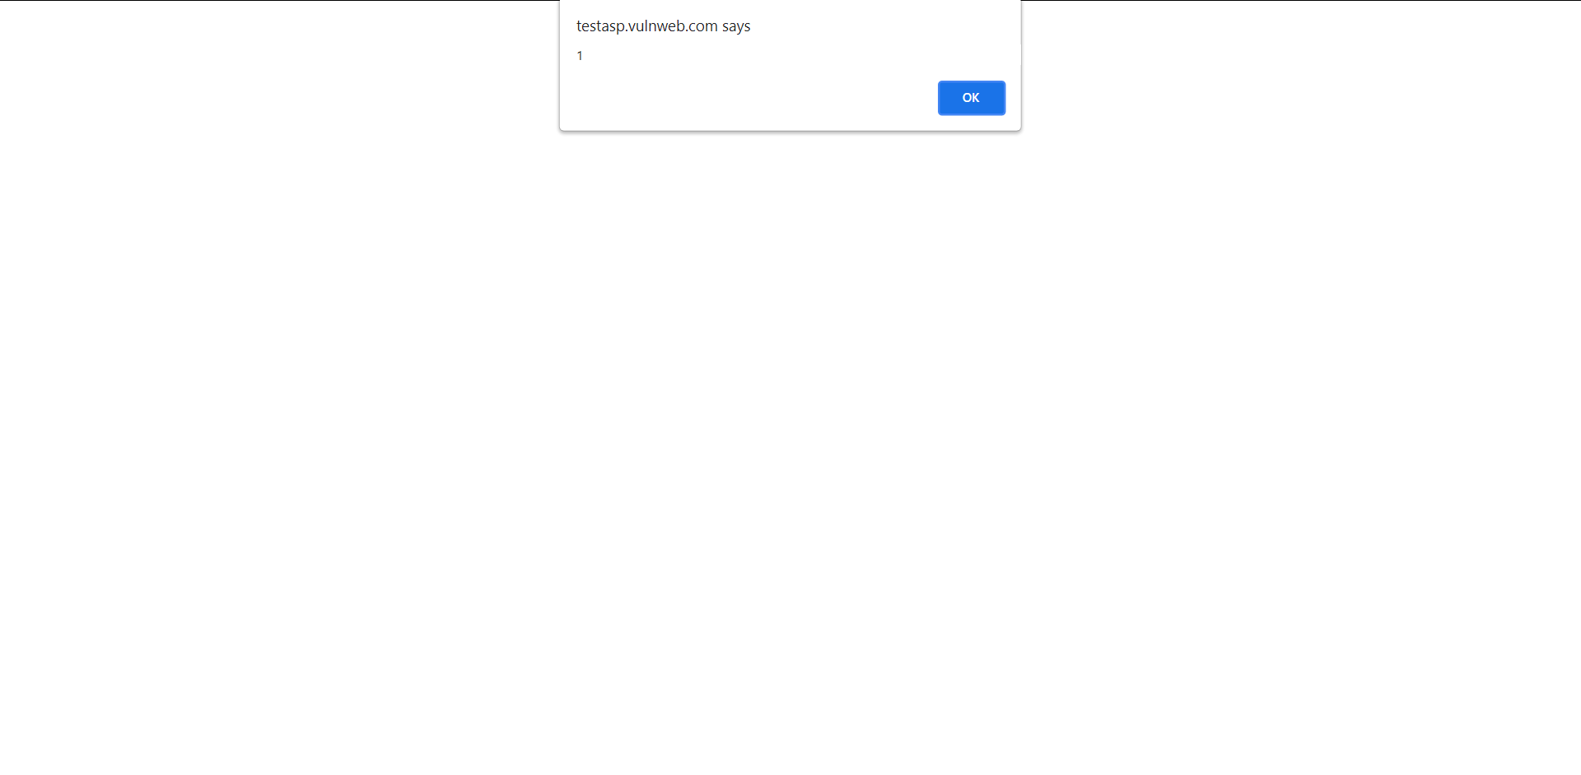
Screenshot:

